Slide 1

Module 15 – SMA-X Project & Program
Jan 2018
Notes:
[STANDARD SLIDE: L300 (animated)]
You can change out the photo with any image from Getty Images in DropBox.
If the main title is shorter, you can make the font larger.
You may have to move the title text around depending on the photo. Make sure the text is readable against the background photo.
You can change the background color for the rectangle in the bottom-right corner to look better against the background. Choose a Micro Focus color at 25% transparency.
=========================
Note to Narrator or Reader: [PRESS] indicates press the Page Down key to show the animation
=========================
Hello and Welcome to the [COURSE_NAME] Technical Overview Training, Level 300.
In this course you’ll gain a high-level understanding of the essentials of [PRODUCT_NAME].
[PRESS] If you want to download this presentation and save it on your own system, click the Tools & Help icon in the bottom-right corner of your window and select Download.
Or, if you want to access the PPT slides and speaker notes for future reference, go to the Attachments tab in your window click to download the presentation.

Slide 2
Objectives
After completing this module, you should be able to:
Describe the features of Project and Program Management in SMA-X
Understand the Portfolio optimization capabilities
Create a Project, Program and Portfolio in SMA-X

Slide 3
Idea & Proposal

Slide 4
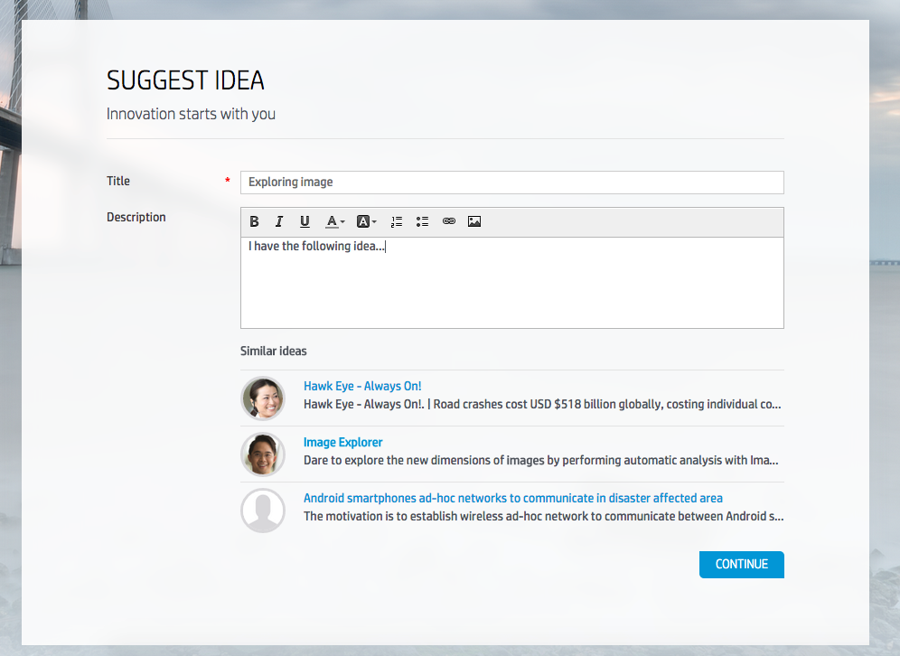
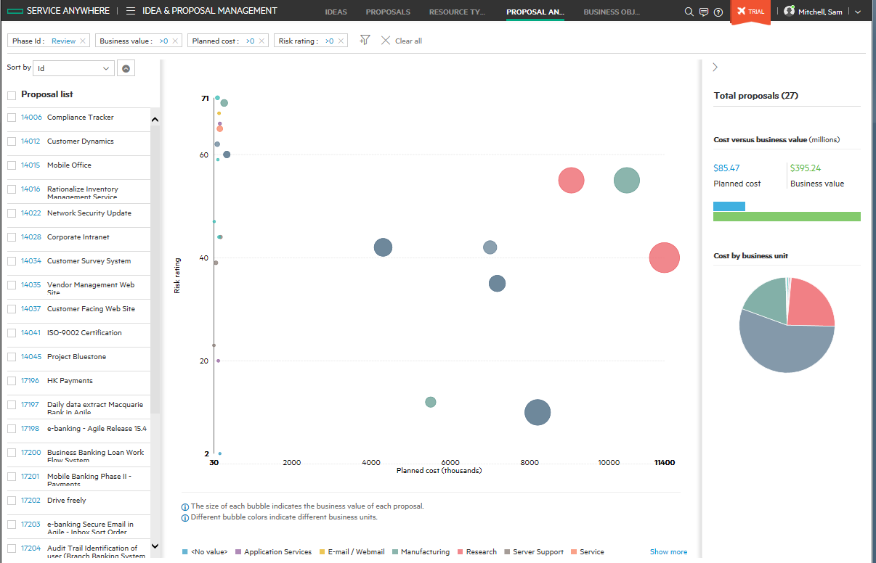
Idea and Proposal Management
Improve IT customer satisfaction and innovate by leveraging power of crowdsourcing
Business users can submit ideas from the Employee Self-service Portal
Provide service users with an actionable forum for sharing their ideas and enhancement requests
Approval governance
Define default approval process for all ideas
Define specific approval processes for strategic ideas
Formal processes to analyze the input to initiate and drive service proposals or change requests
Business objectives and focused analytics features, provide visibility into the cost/benefit opportunities

Slide 5
Project portfolios

Slide 6
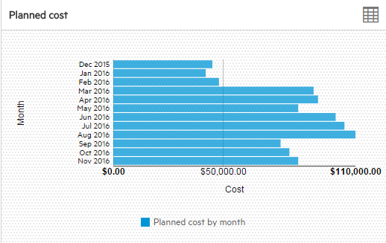
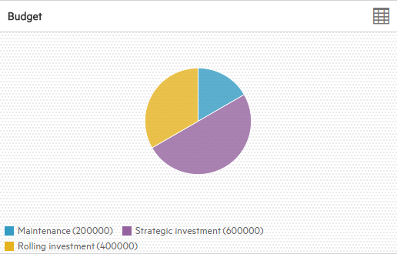
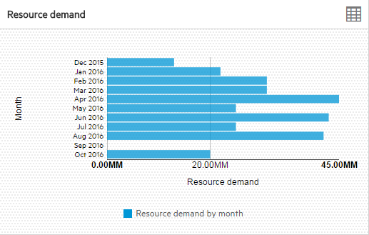
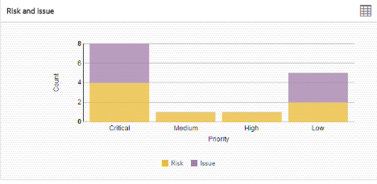
Executive Summary
Menu -> Project & Program
Default view is Executive Summary
Provides a list of project portfolios
Summary charts are for highlighted project portfolio
Planned cost by month
Budget by type
Resource demand by month
Risk & Issue – Count / priority

Slide 7
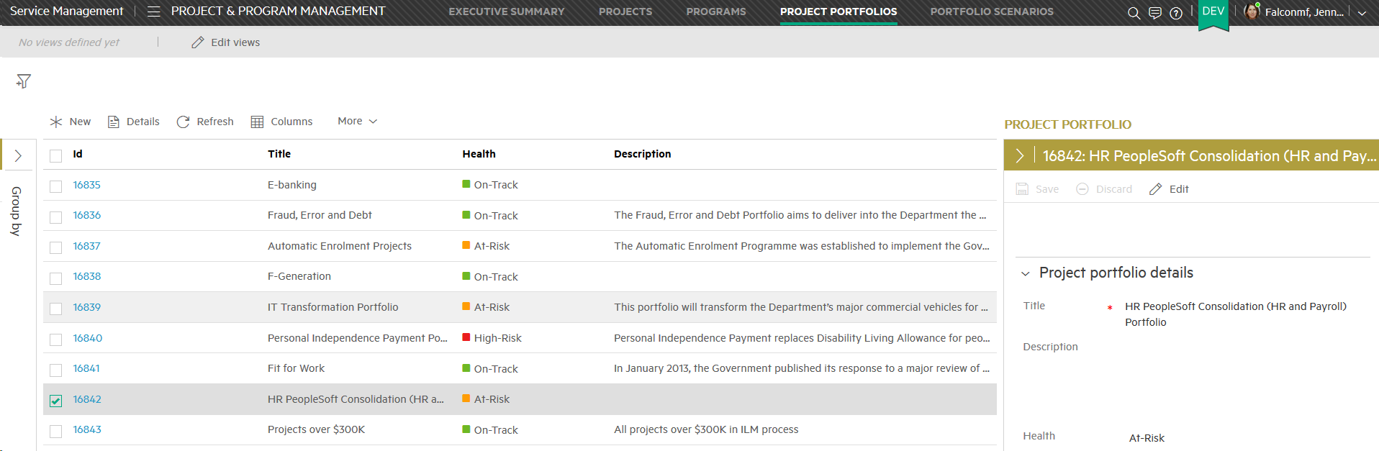
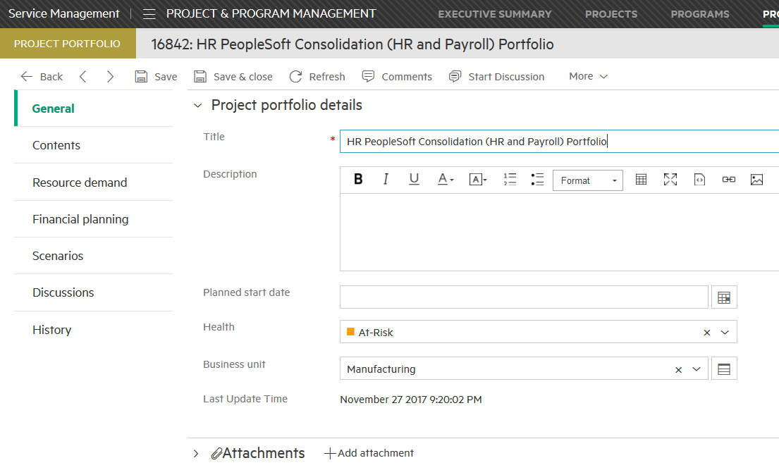
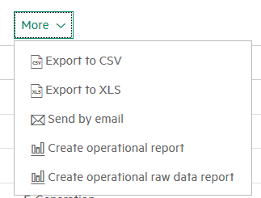
Project portfolios
Menu -> Project and program -> Project portfolio
Lists all project portfolios
Highest level of grouping / management
Full financial summary
Can export list to CSV or XLS
Can create operational or operational raw data report

Slide 8
Program management

Slide 9
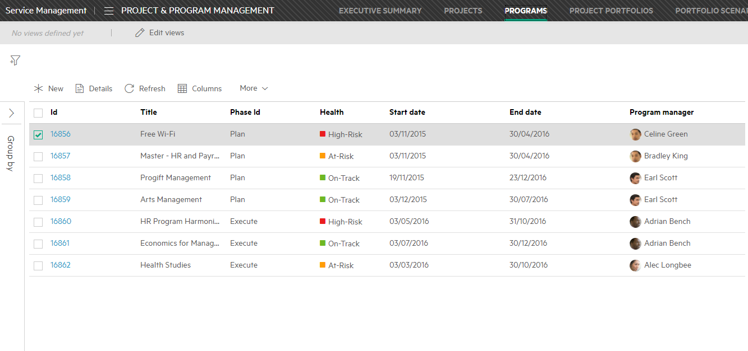
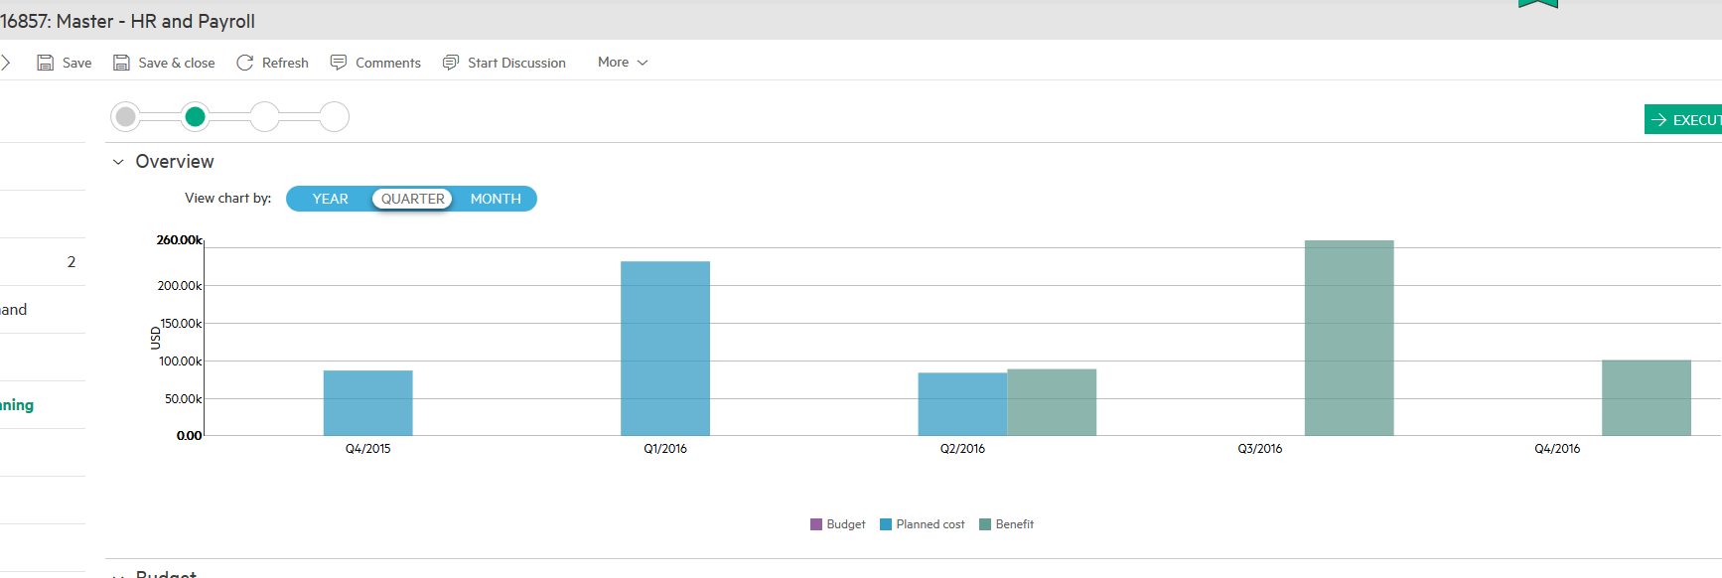
Programs
Menu -> Project & Program -> Programs
Manage group of related projects
Default is a list of programs
Timeline tab: Shows only active roadmap for each member project
Financial summary: has budget, cost and benefit
Can log issues (current problems) and risks (potential problems) to program level
Can send list to CSV or XLS
Can create operational report or operation raw data report
Health is manually selected from a dropdown

Slide 10
Project management

Slide 11
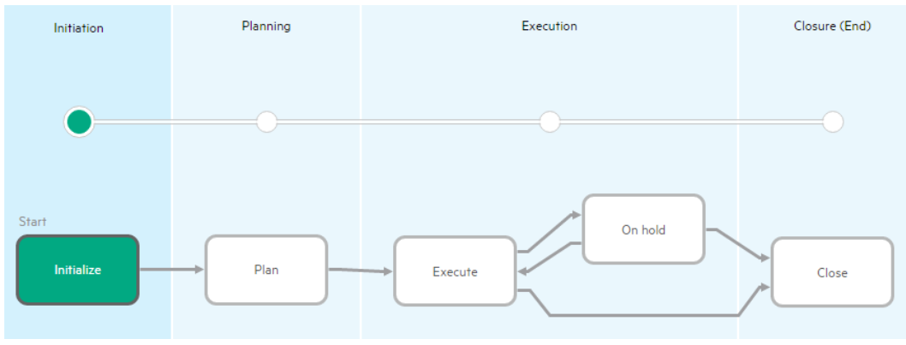
Project record workflow
Notes:
Initialize - This is the beginning phase of a project, where the initial project scope, project resources, stakeholders and project manager are identified.
Plan - In this phase, the project manager clarifies the project's scope and schedules, defines project management plan and project objectives, and fulfills the resources needed for the project.
Execute - The project is being executed. - Move the project record to the On hold phase if the project is blocked and can no longer be executed.
On hold - This phase can be used if, for example, there are budget issues or the investment in the project has changed.
Close -In this phase, the project is closed and accepted by the customer or sponsor.

Slide 12
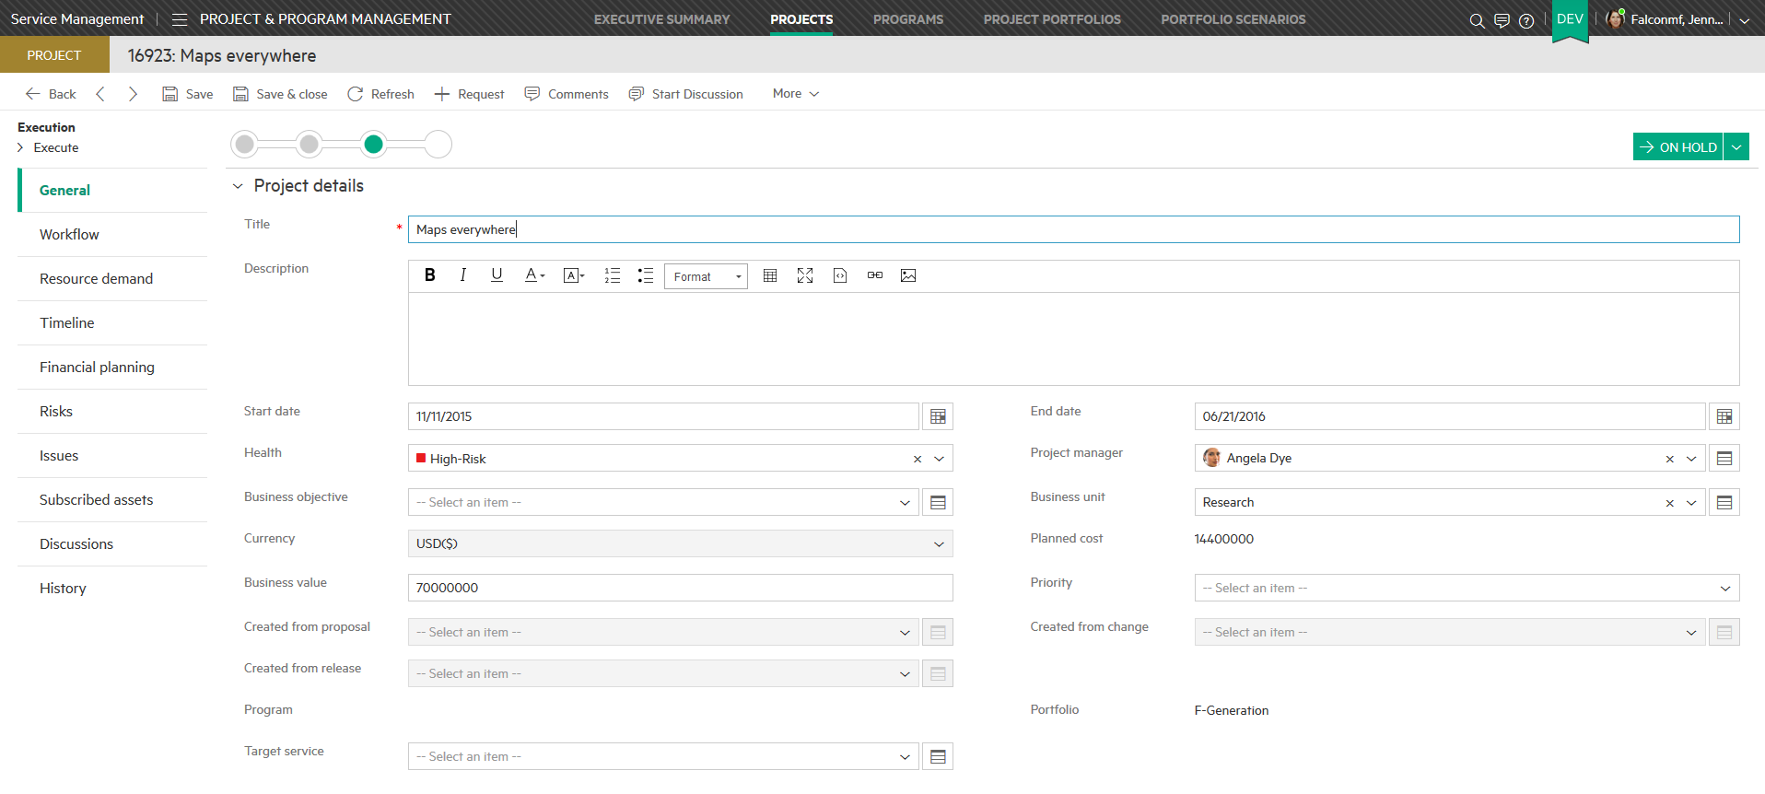
Projects
Menu -> Project & Program -> Projects
A list of projects
Added to a program or portfolio from the program / portfolio entity
There are enforced rules of inclusion to avoid double counting
Once an entity belongs to a portfolio or program it is not presented as an option for a different project or program
Planned cost is roll-up from Financial Summary
Only represents role requirements, not labor expense
Requirements expressed in Man Months (MM)

Slide 13
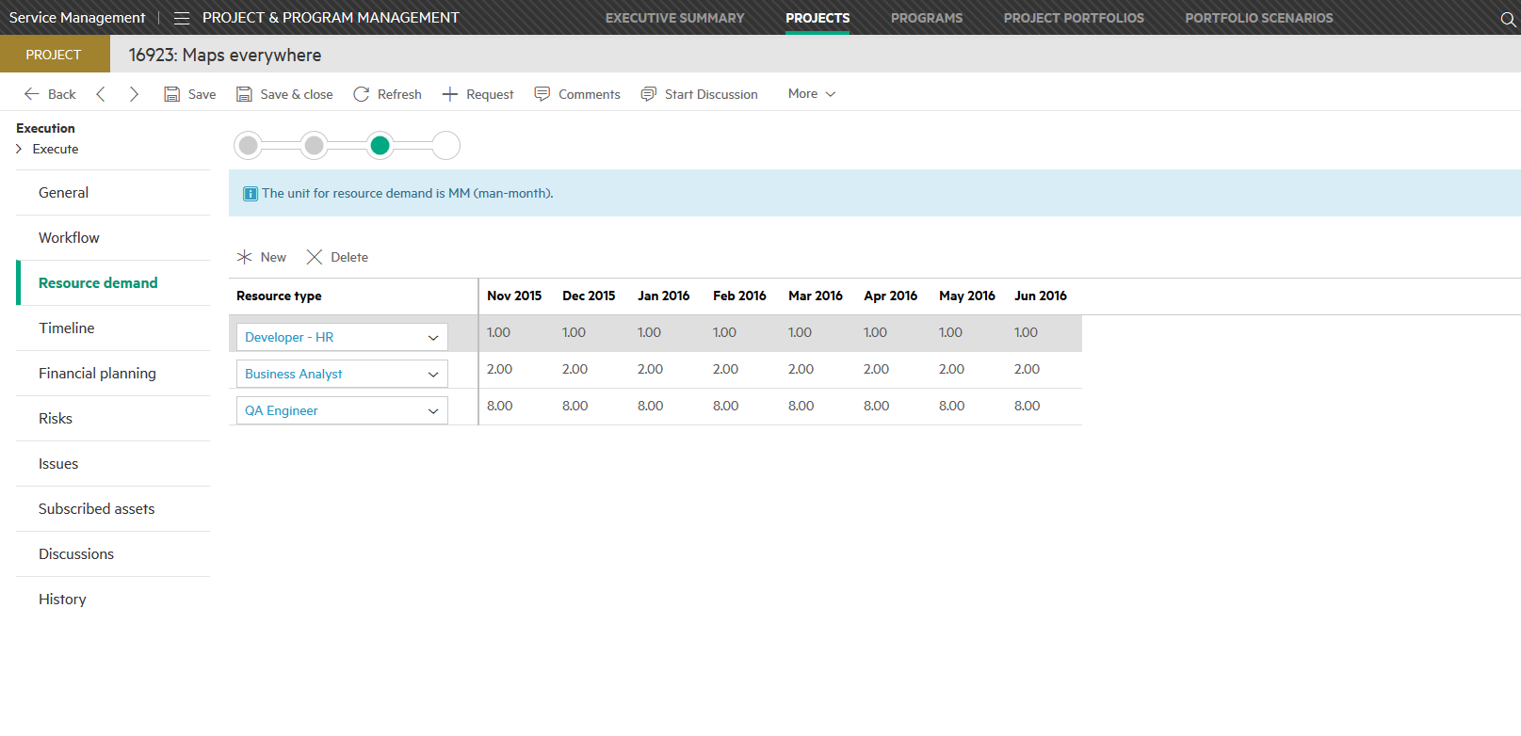
Projects
Menu -> Project & Program -> Projects
Timeline
List of roadmaps
Only one active roadmap
Financial summary
Risks
Issues
Notes:
Risks Something that may happen to jeopardize the project
Issues Something that has happened that needs mitigation
High level budget, costs, and benefits

Slide 14
Project General tab
Manually set
Roll- up from Financial summary
Has rules of inclusion

Slide 15
Project Resource demand tab
Man Months (MM)
Resource role
Resource demand

Slide 16
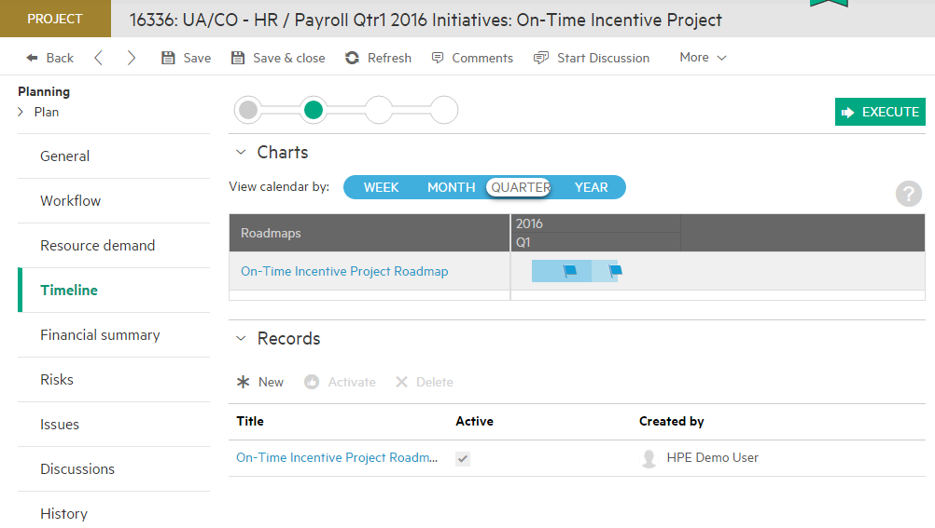
Project Timeline tab
Can have multiple roadmap records; only active one is displayed in chart / program

Slide 17
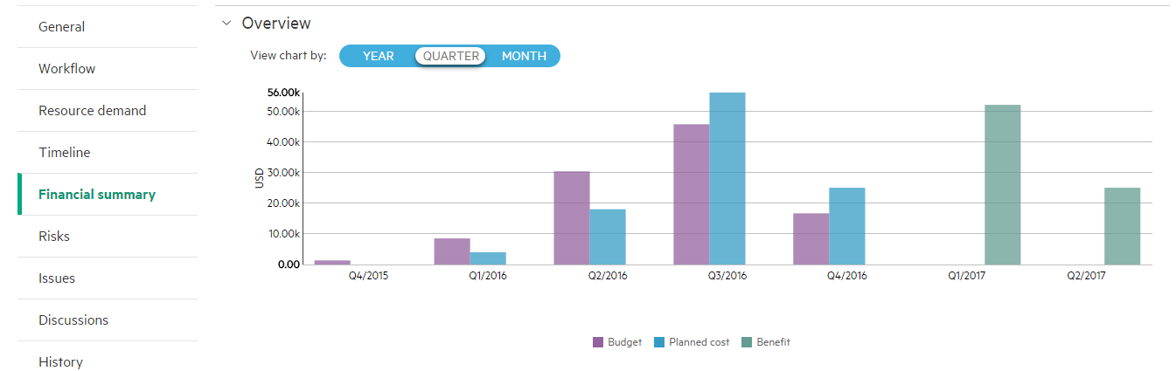
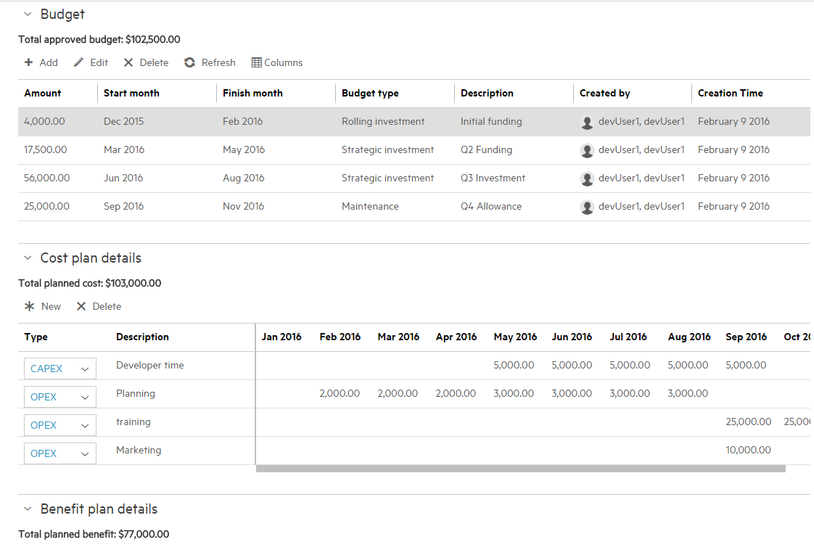
Project Financial summary tab
Summary section
Each detail section has summary number
Detail section
Total planned cost posts to general tab

Slide 18
Portfolio Optimization

Slide 19
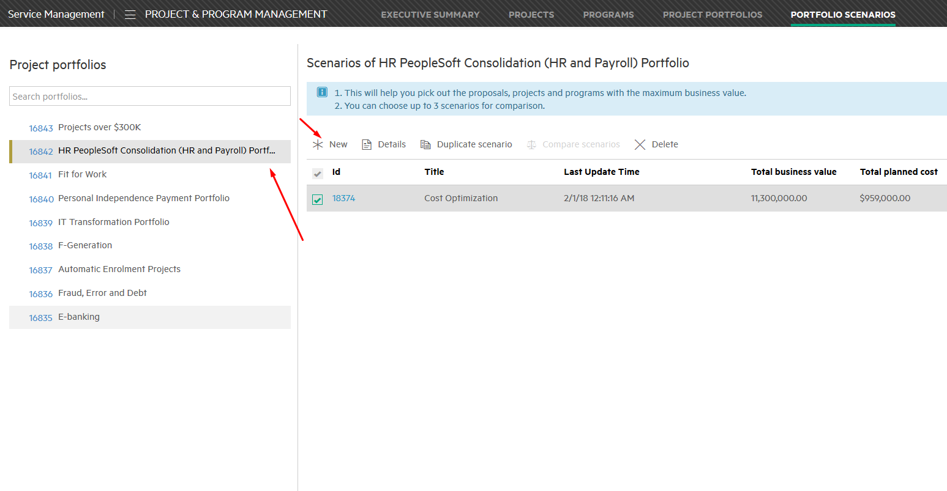
Project optimization scenarios
Menu -> Project & Program -> Projects
Notes:
Project portfolio scenarios are sets of selections of the proposals that are included in the project portfolios. Scenarios help you understand the business consequences of different selections. You can use manual or automatic optimization to find the best selection of proposals that meets the business objective, while not breaking any resource or budget constraints.

Slide 20
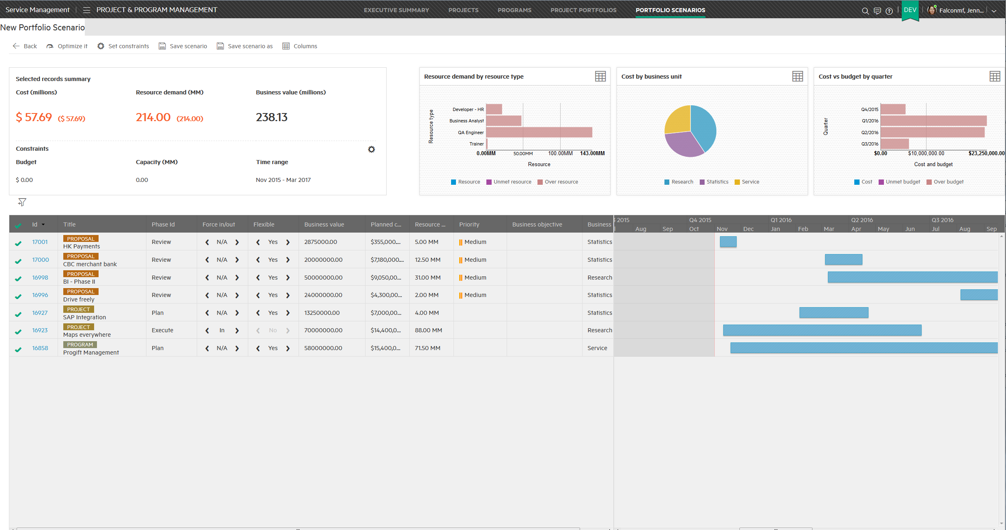
New Scenario

Slide 21
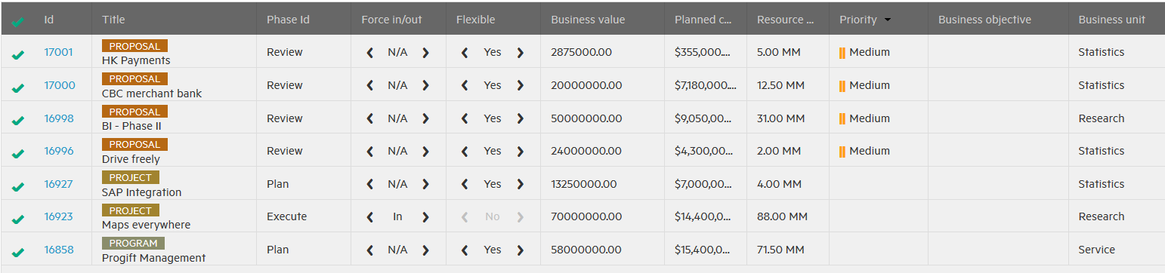
Relevant portfolio items
Notes:
The bottom of the screen displays a table that includes all items in the portfolio that are relevant for the optimization. It includes key information – ID, Title, Business value and others
An additional column (Force In/Out) and Flexible is used for automatic optimization. Basically they mean if Auto-optimization could change this records or not.

Slide 22
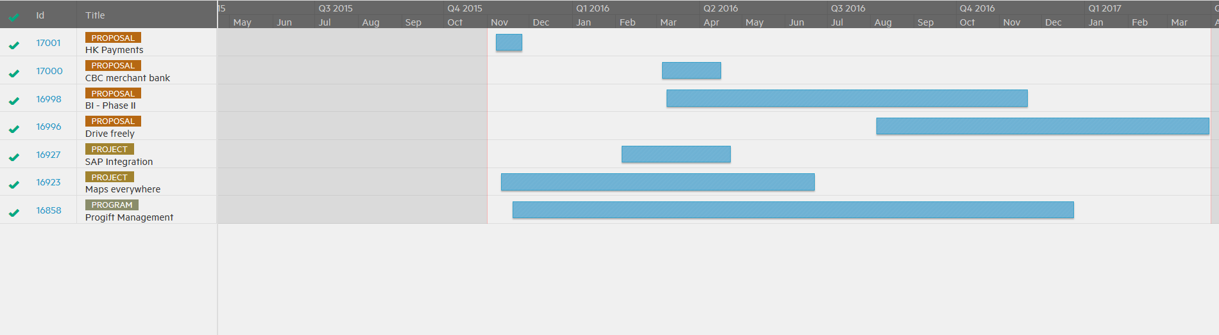
Gantt chart for optimization
Notes:
The Gantt chart shows the current schedule of all suggested items. The total time span begins with the earliest start date of an item and ends with the latest end date of an item.

Slide 23
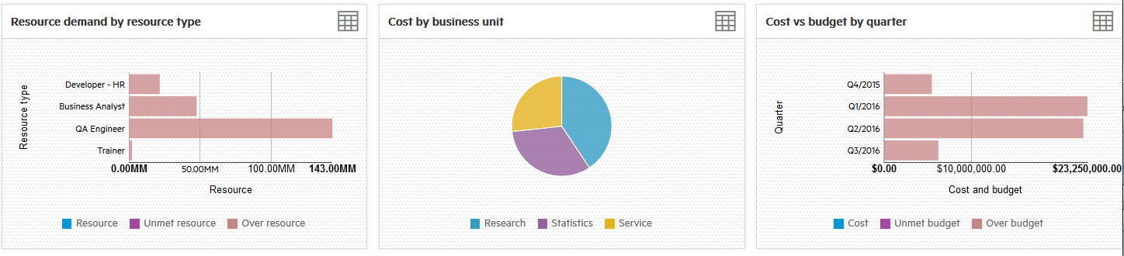
Cost & Resources charts
Notes:
The top right of the scenarios screen displays three charts:
Resource demand by resource type
This chart shows the resource fulfillment status for each resource type.
Cost by business unit
This chart shows the cost distribution between different business units for all selected items.
Cost vs budget by quarter
This chart shows the budget and cost status for each quarter during the time range.

Slide 24
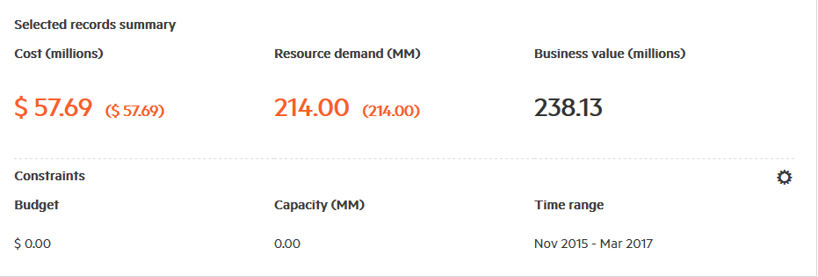
Key statistics
Notes:
The top left of the scenarios screen displays three key statistics:
Cost and budget
This displays the total cost within the time range for all the selected items in the table.
Resource demand and capacity
This item includes the total resource demand within the time range for all of the selected items in the table.
Business value and time range
This item shows the total business value within the time range for all of the selected items in the table.

Slide 25
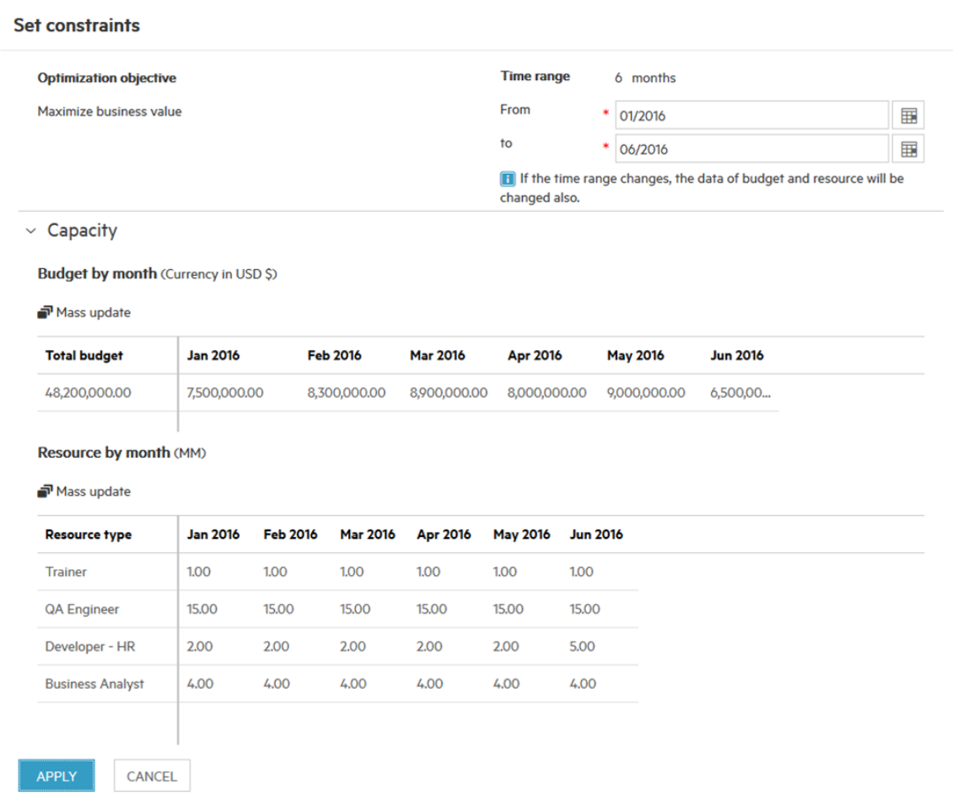
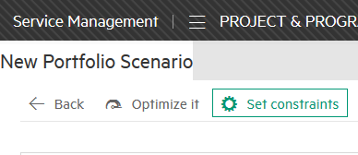
Set constraints
Notes:
This sections allows user to set constraints for his portfolio optimizations. The optimization objective is Maximize business value. User can set time range for optimization, and capacity which includes budget and resources (it is possible to use mass update to have changes to all positions in relevant percentage).

Slide 26
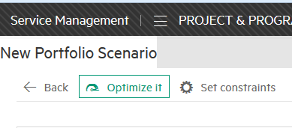
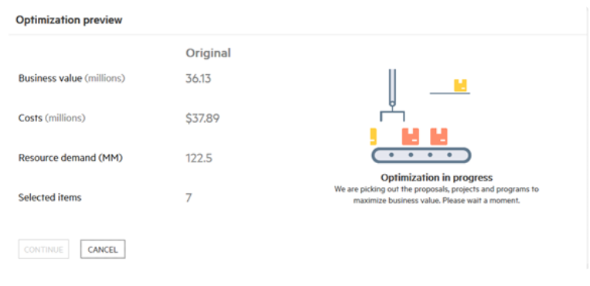
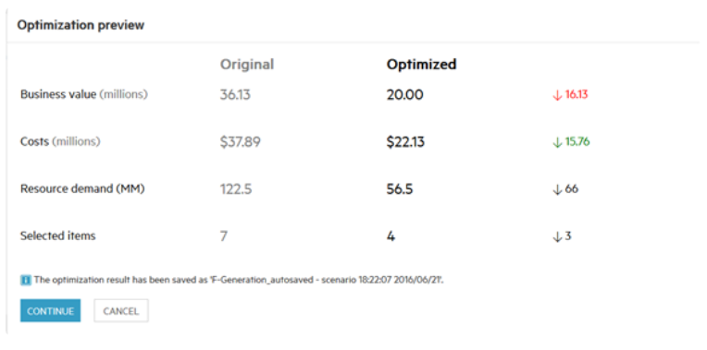
Auto-optimization results
Notes:
in the automatic optimization, the optimization engine takes care of the resource demand and planned cost in each month to ensure they could be covered by budget and available capacity, which is much more difficult to do with manual optimization.

Slide 27
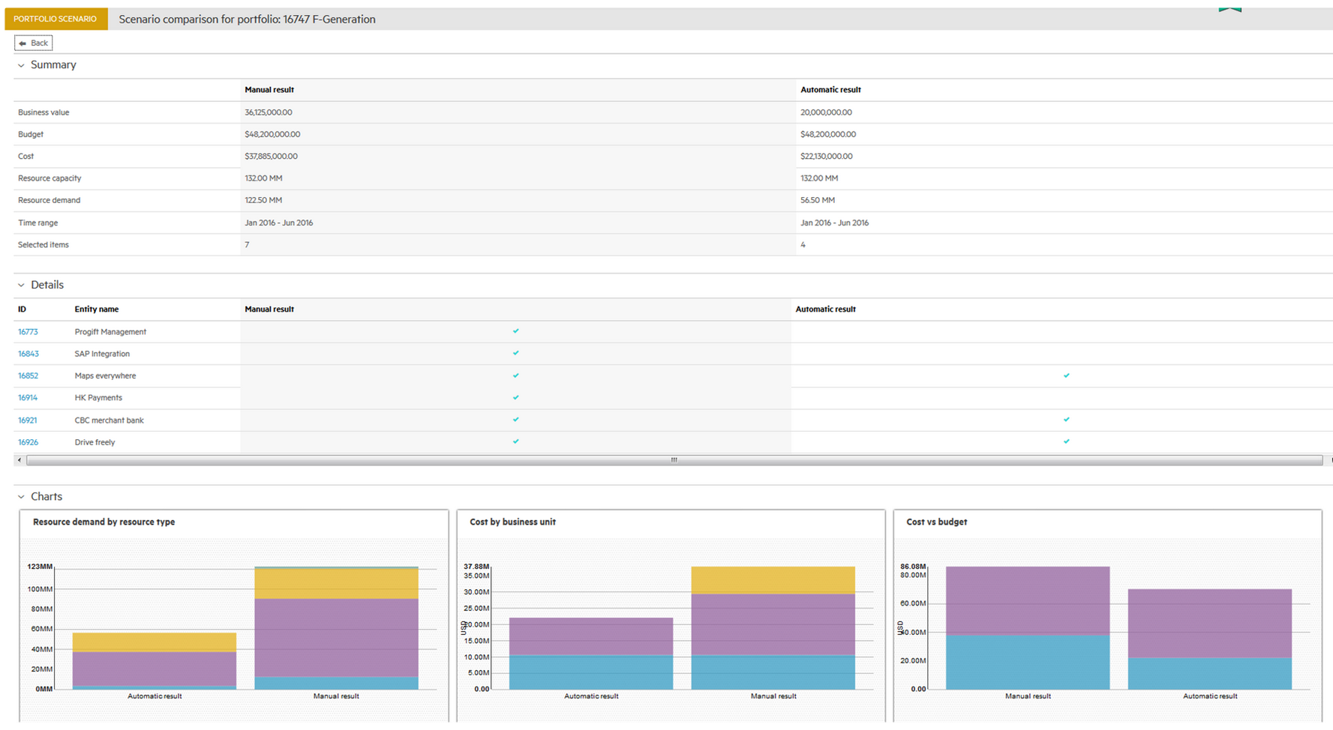
Scenario comparison

Slide 28
Summary
Project Management features

Slide 29
SMA-X project management features summary
Provides basic portfolio, program, and project structure and features
Programs, projects, and proposals can be directly associated with a portfolio
Go to the “container” entity to add contents
i.e., go to a program to add projects
i.e., go to a portfolio to add proposals, projects, and/or programs
Resource roles are created in the Idea & Proposal area
Resource load can be used on proposals & projects
Financial summaries are available on proposals, projects, programs and portfolios
Portfolio optimization allows to manually/automatically find best solution for proposal to meet business objective not breaking any constraints

